Slide 1
A PowerShell challenge
Mark Gossa
Commercial Infrastructure Engineering Lead
Vanquis Bank

Slide 2
About me
Twitter: @markgossa
Blog: https://markgossa.blogspot.com
GitHub: https://github.com/markgossa

Slide 3
About Vanquis
Vanquis are a consumer credit organisation
Focused on the sub-prime market
Range of products on offer, most popular are range of credit builder credit cards
Circa 1.7m customers

Slide 4
Overview
The challenge
Where to start?
How do we get there?
Problems and workarounds
The Vanquis challenge

Slide 5
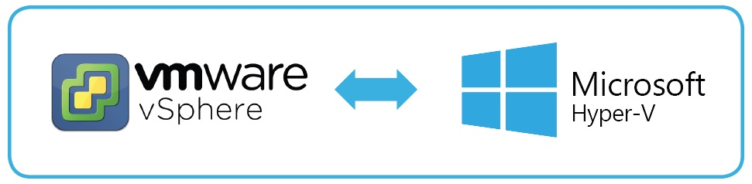
The challenge
Migrate from VMware to Hyper-V
Notes:
600 Windows VMs

Slide 6
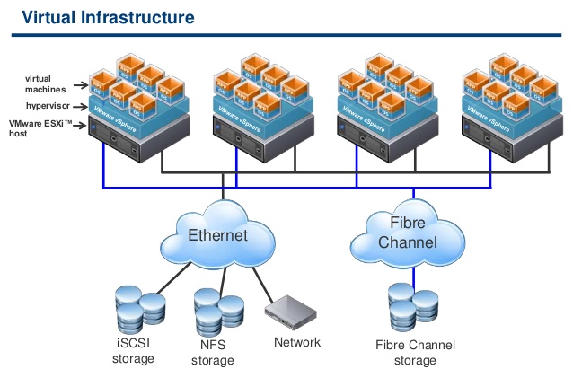
What is VMware vSphere?
vCenter

Slide 7
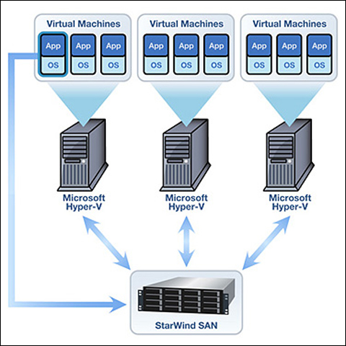
What is Hyper-V?
System Center Virtual Machine Manager

Slide 8
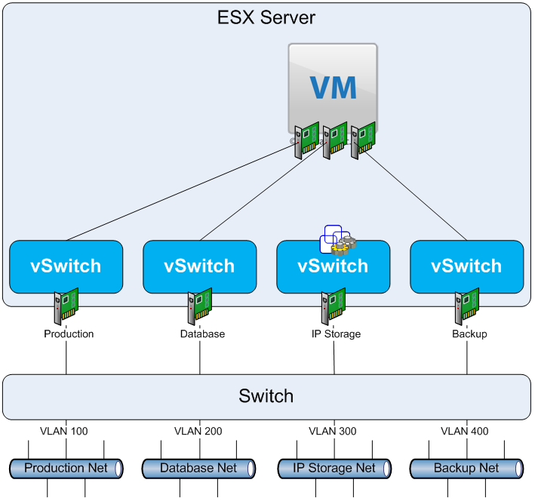
Networking
VLAN Isolation

Slide 9
The challenge
Migrate from VMware to Hyper-V
Minimal downtime
No cost implications
Notes:
600 Windows VMs
No downtime = Can’t use free tools e.g. MVMC, SCVMM, disk2vhd
No cost = No tools like Zerto, PlateSpin, Double-Take etc

Slide 10
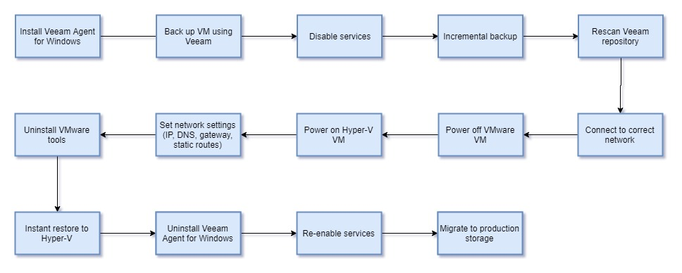
How to do it manually?
Notes:
What is Veeam?
Process
Always a good start before automating is figuring out how to do it manually.
Sometimes we just want to write code and we start there but actually we may be writing code for hours and then just realise it’s a dead end.
Is it worth automating? 28 page document (1-2hrs manually, 600VMs)

Slide 11
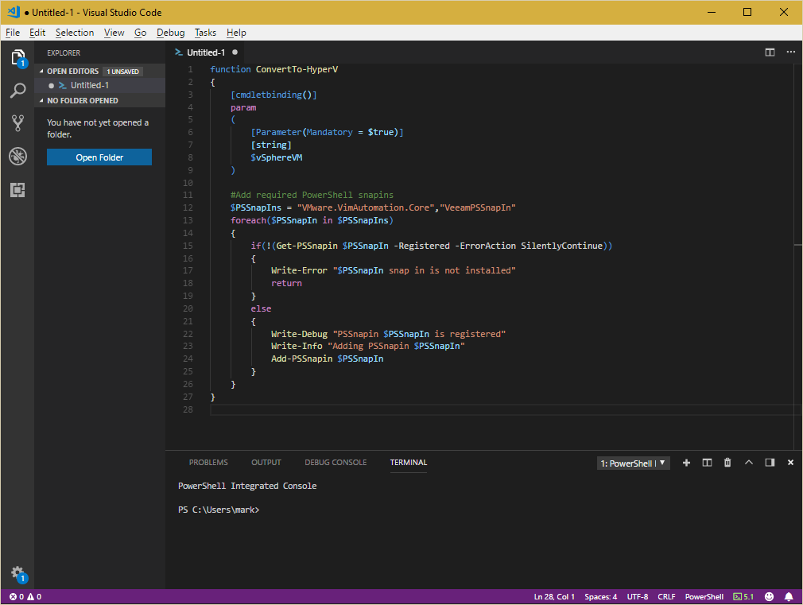
Where to start?
Not here
Notes:
This is not where to start
I found that it’s best not to start writing code straight away

Slide 12
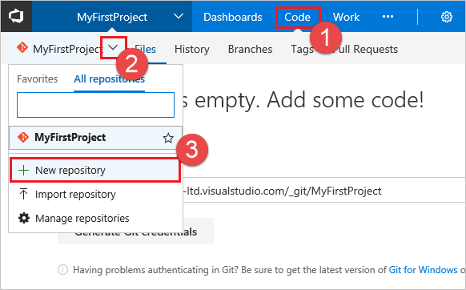
Where to start?
Here
Notes:
Create a VSTS repo

Slide 13
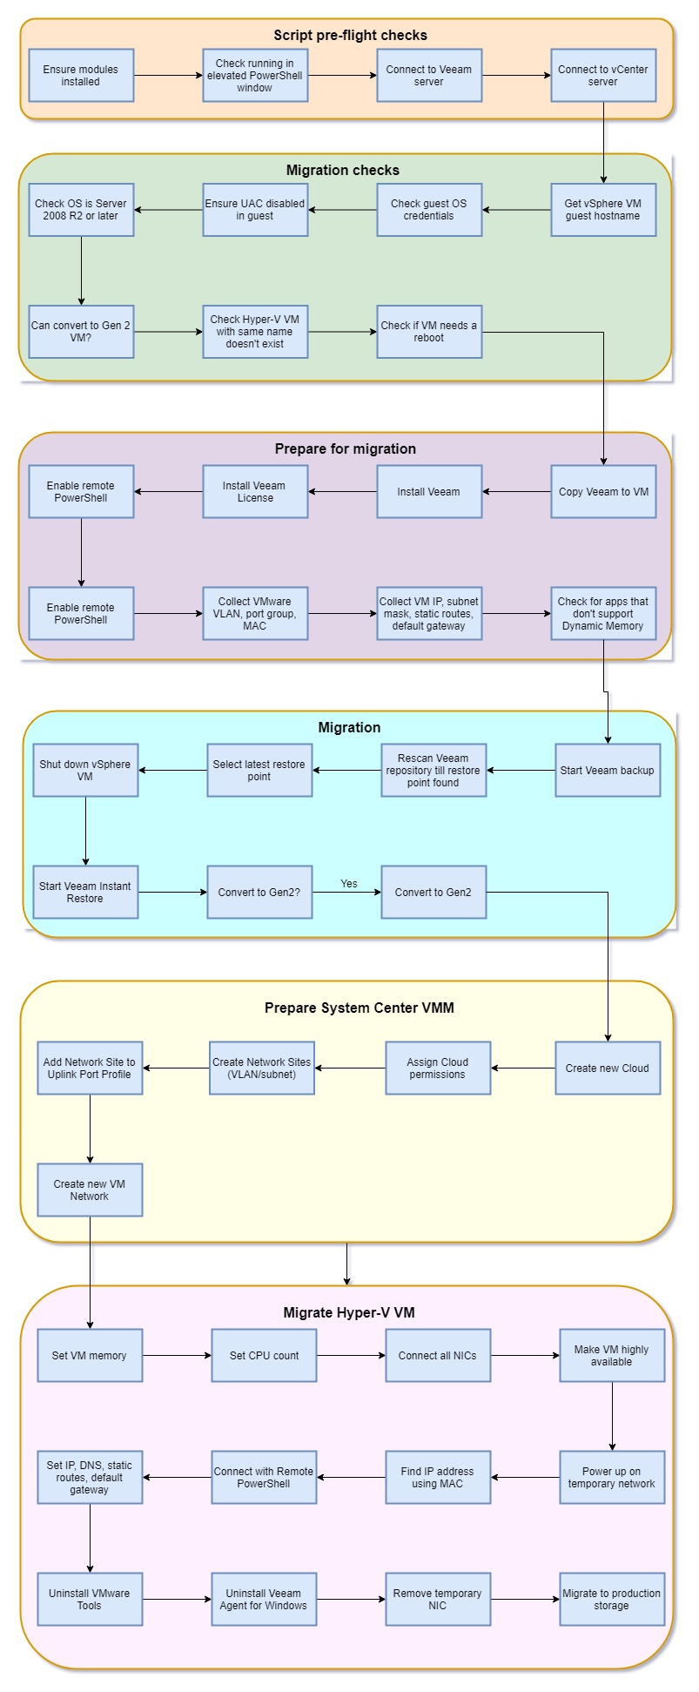
Where to start?
Plan out the steps (write out a list of functions)

Slide 14
Where to start?
Plan out the steps (write out a list of functions)
Notes:
Modular PowerShell scripts are easier to manage
VSCODE - 1
What’s a simple function? What’s an advanced function?
Additional helper functions

Slide 15
How do we get there?
Plan out the steps (write out a list of functions)
Check feasibility (find modules and cmdlets)
Write out what each function should do
Write out tests
Write out functions (to pass unit tests)
Create a module
Test in test environment (integration tests)
CI/CD pipeline (advanced)
Notes:
VSCODE - 2
Feasibility: Find modules and commands
Get help about cmdlets
VSCODE - 3
When you think of all the tests that Pester does and then you create and run those tests, it's then when you work out that your code only really works in that one situation :-)
Mocks
Assert mock called
VSCODE – 4
Write out the tests
Write function
Test
VSCODE – 6
Create a module

Slide 16
Problems and workarounds
Same cmdlet, different module
Copy files to VMs without networking
Run commands on VMs without networking
Wait for long running operations
Convert prefix length to subnet mask
Cmdlets not available in Server 2008 R2
Server 2008 R2 VM powers up with no networking on Hyper-V
Error handling
Network ID calculator
Notes:
VSCODE – 7

Slide 17
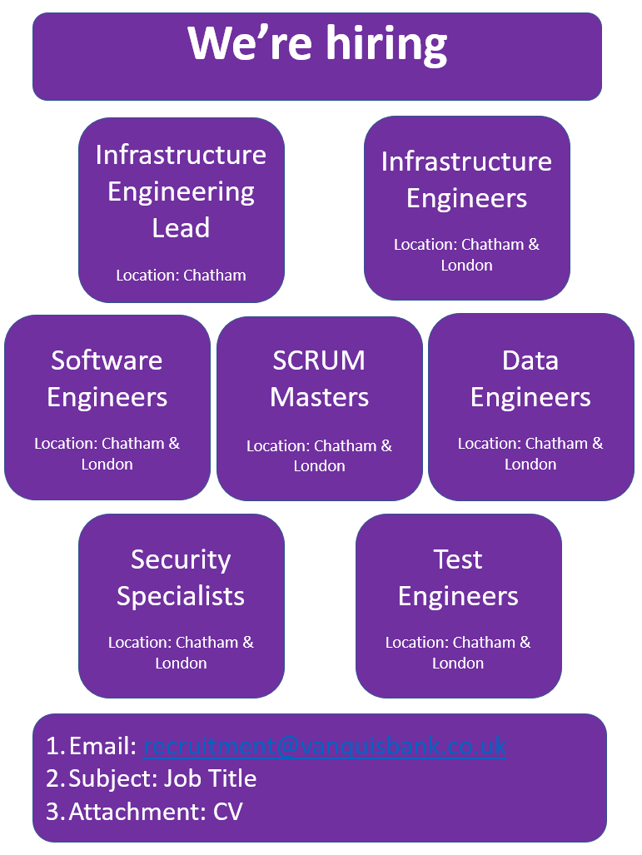

The Vanquis Challenge
Automate VM deployment (on-premise/Azure)
Azure PaaS and AKS
Linux and Windows
No manual changes
CI/CD pipelines for all infrastructure
Automation culture:
PowerShell
PowerShell DSC
Terraform
Ansible
Python
Training

Slide 18


